Slide 1
Introduction to Cloud
By
Vivek Arora

Slide 2
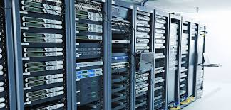

Slide 3
On-Premises Server
On-premises servers refer to physical servers that are located within an organization’s own facilities or data center. Unlike cloud servers, which are hosted and managed by third-party cloud service providers, on-prem servers are owned and managed by the organization itself.

Slide 4
Key Characteristics of On-Prem Servers
Physical Location:
In-House Infrastructure: On-prem servers are physically located within the organization’s premises, such as a data center or server room.
Control: The organization has complete control over the physical and environmental aspects of the servers, including cooling, power, and physical security.
Ownership and Management:
Capital Expenditure: Organizations purchase and own the hardware, which involves a capital expenditure (CapEx) for acquiring and maintaining the equipment.
Maintenance: The organization is responsible for all maintenance tasks, including hardware repairs, upgrades, and replacements.

Slide 5
Customization:
Tailored Configurations: Organizations can customize hardware and software configurations to meet specific needs or requirements.
Security and Compliance:
Data Security: Organizations have direct control over physical and network security measures, which can be crucial for compliance with regulatory requirements.
Compliance: It can be easier to ensure compliance with certain regulatory standards by keeping sensitive data on-premises.
Network Latency:
Local Access: On-prem servers can offer lower network latency for users accessing applications and data locally within the organization.

Slide 6
Pros -
Control and Customization: Full control over hardware, software, and configurations. Customization to meet specific needs is possible.
Security: Direct control over physical and network security measures, which can enhance security and compliance for sensitive data.
Data Privacy: Full ownership and control over data without relying on third-party providers.

Slide 7
Cons -
High Initial Costs: Significant capital expenditure for purchasing hardware, licenses, and other infrastructure components.
Maintenance and Management: Responsibility for ongoing maintenance, upgrades, and troubleshooting. Requires dedicated IT staff and resources.
Scalability: Limited scalability compared to cloud solutions. Expanding capacity involves purchasing and installing additional hardware.
Disaster Recovery: Requires planning and investment in backup and disaster recovery solutions. Ensuring high availability and business continuity can be more challenging.

Slide 8
Use Cases for On-Prem Servers
Regulatory Compliance: Organizations that need to comply with strict regulatory or data privacy requirements may prefer on-prem servers to maintain direct control over their data.
Sensitive Data: Companies dealing with highly sensitive or proprietary information may choose on-prem servers for enhanced security and control.
Legacy Systems: Organizations with legacy applications or systems that are not compatible with cloud environments may continue to use on-prem servers.
Custom Hardware Needs: Situations requiring specialized hardware configurations or performance optimizations may benefit from on-premise solutions.

Slide 9


Slide 10
Cloud Computing
Cloud computing is the delivery of computing services—including servers, storage, databases, networking, software, and more—over the internet (“the cloud”). This model allows users to access and manage computing resources on-demand without needing to own or maintain physical hardware.

Slide 11
Core Concepts
On-Demand Self-Service:Users can provision computing resources as needed without requiring human intervention from the service provider.
Broad Network Access:Services are accessible over the network from a variety of devices, such as laptops, smartphones, and tablets.
Resource Pooling:Cloud providers pool computing resources to serve multiple customers using a multi-tenant model. Resources are dynamically allocated and reassigned according to demand.
Rapid Elasticity:Resources can be scaled up or down quickly and efficiently to meet changing demand, providing flexibility and scalability.
Measured Service: Cloud systems automatically control and optimize resource use by leveraging metering capabilities, which provide transparency into resource usage and billing.

Slide 12
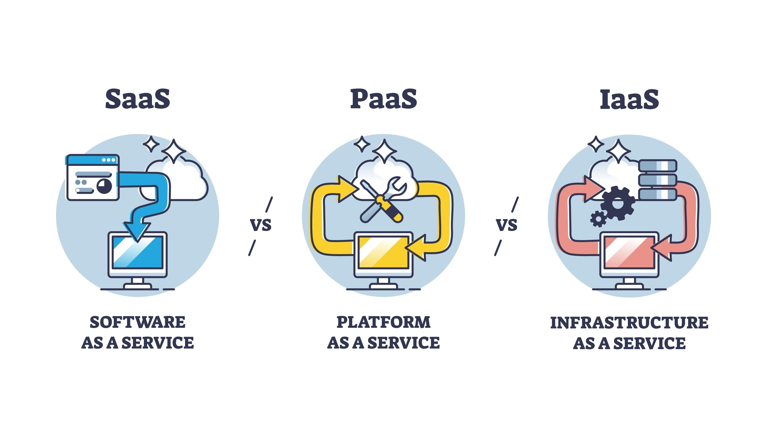

Slide 13
Cloud Service Models
Infrastructure as a Service (IaaS):
Definition: Provides virtualized computing resources over the internet. Users can rent virtual machines, storage, and networking components.
Examples: Amazon Web Services (AWS) EC2, Microsoft Azure Virtual Machines, Google Compute Engine.
Platform as a Service (PaaS):
Definition: Offers a platform that allows developers to build, deploy, and manage applications without worrying about the underlying infrastructure.
Examples: Google App Engine, Microsoft Azure App Services, AWS Elastic Beanstalk.
Software as a Service (SaaS):
Definition: Delivers software applications over the internet, on a subscription basis. The service provider manages the infrastructure and platforms.
Examples: Google Workspace, Microsoft Office 365, Salesforce.

Slide 14
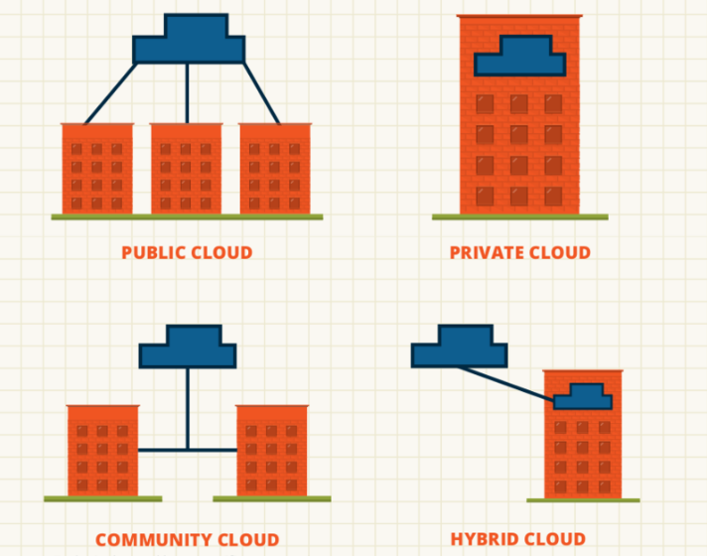

Slide 15
Cloud Deployment Models
Public Cloud:
Definition: Services are offered over the public internet and shared across multiple organizations. The cloud provider owns and operates the infrastructure.
Examples: AWS, Azure, Google Cloud Platform (GCP).
Private Cloud:
Definition: Cloud infrastructure used exclusively by a single organization. It can be hosted on-premises or by a third-party provider.
Examples: VMware vSphere, Microsoft Azure Stack, OpenStack.
Hybrid Cloud:
Definition: A combination of public and private clouds, allowing data and applications to be shared between them. It provides flexibility and optimization for different workloads.
Examples: AWS Outposts, Azure Arc, Google Anthos.
Community Cloud:
Definition: Cloud infrastructure shared by several organizations with common concerns (e.g., security, compliance). It can be managed by one of the organizations or a third-party provider.
Examples: Government or healthcare community clouds.

Slide 16
Key Benefits of Cloud Computing
Cost Efficiency:
Pay-as-You-Go: Pay only for the resources you use, reducing capital expenditure and operational costs.
Reduced Infrastructure Costs: Eliminate the need for investing in and maintaining physical hardware.
Scalability and Flexibility:Elasticity: Scale resources up or down based on demand, allowing for efficient resource utilization and handling of peak loads.
Global Reach: Access resources and services from anywhere in the world, with global data centers offering low latency and high availability.
Accessibility:Remote Access: Access applications and data from any device with an internet connection, improving collaboration and productivity.
Automatic Updates: Cloud providers manage software updates and patches, ensuring you always have access to the latest features and security improvements.
Disaster Recovery and Backup:Resilience: Cloud providers often have built-in redundancy and backup solutions, enhancing data protection and disaster recovery capabilities.
Innovation:Rapid Deployment: Quickly deploy and test new applications or features without waiting for hardware setup.
Access to Advanced Technologies: Utilize cutting-edge technologies such as artificial intelligence (AI), machine learning (ML), and big data analytics provided by cloud services.

Slide 17
Cloud Providers and Platforms
Cloud providers offer a range of services and solutions for computing, storage, networking, and more. Here’s an overview of some of the major cloud providers and their platforms:

Slide 18
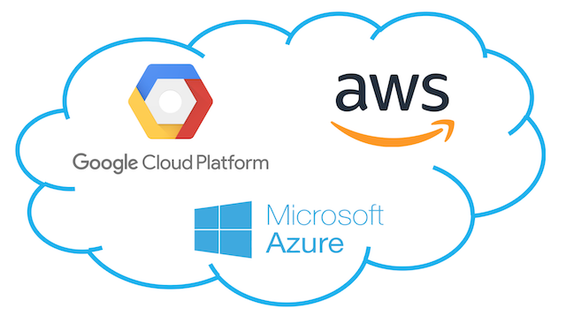

Slide 19
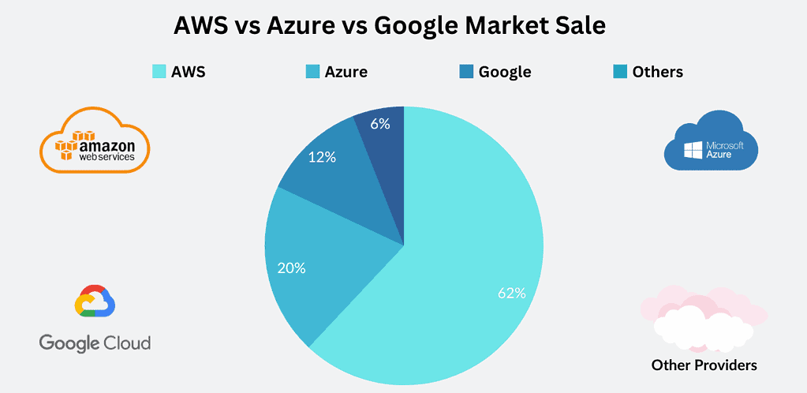

Slide 20
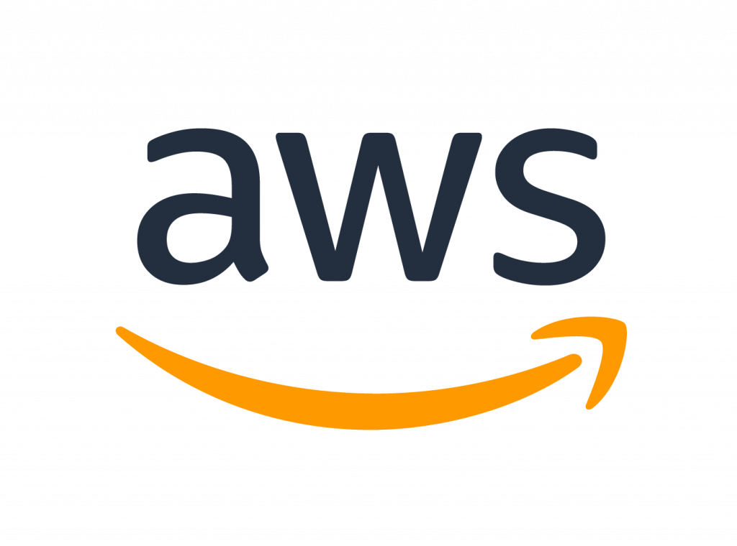
Amazon Web Services (AWS)
Overview: AWS is one of the largest and most comprehensive cloud service providers. It offers a wide range of services across various domains including compute, storage, databases, networking, AI/ML, analytics, and more.
Key Services:
Compute: Amazon EC2 (Elastic Compute Cloud), AWS Lambda (serverless computing)
Storage: Amazon S3 (Simple Storage Service), Amazon EBS (Elastic Block Store)
Databases: Amazon RDS (Relational Database Service), Amazon DynamoDB (NoSQL database)
Networking: Amazon VPC (Virtual Private Cloud), AWS CloudFront (Content Delivery Network)
AI/ML: Amazon SageMaker, AWS Rekognition (image and video analysis)Features: Extensive global infrastructure, broad service offering, flexible pricing models, strong ecosystem of tools and third-party integrations.

Slide 21
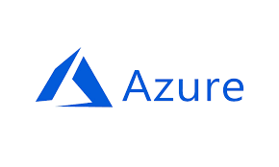
Microsoft Azure
Overview: Azure is Microsoft’s cloud computing platform, offering a wide range of services for computing, storage, networking, databases, and more. It integrates well with Microsoft products and enterprise systems.
Key Services:
Compute: Azure Virtual Machines, Azure Functions (serverless computing)
Storage: Azure Blob Storage, Azure Disk StorageDatabases: Azure SQL Database, Azure Cosmos DB (NoSQL database)
Networking: Azure Virtual Network, Azure CDN (Content Delivery Network)
AI/ML: Azure Machine Learning, Azure Cognitive ServicesFeatures: Strong integration with Microsoft products, hybrid cloud capabilities (Azure Arc), extensive global reach, enterprise-grade security and compliance.

Slide 22
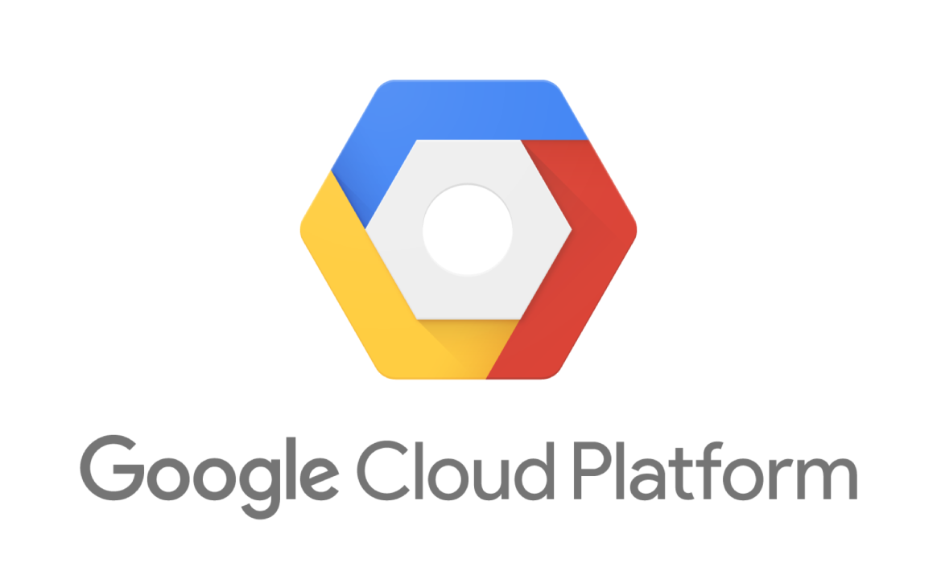
Google Cloud Platform (GCP)
Overview: GCP provides a suite of cloud computing services including compute, storage, databases, and machine learning, leveraging Google’s infrastructure and data analytics capabilities.
Key Services:
Compute: Google Compute Engine (VMs), Google Cloud Functions (serverless computing)
Storage: Google Cloud Storage, Persistent Disk
Databases: Google Cloud SQL, Google Firestore (NoSQL database)
Networking: Google VPC, Google Cloud CDN (Content Delivery Network)
AI/ML: Google AI Platform, TensorFlow, AutoMLFeatures: Advanced data analytics and AI/ML capabilities, strong global network infrastructure, seamless integration with Google’s services and tools.

Slide 23
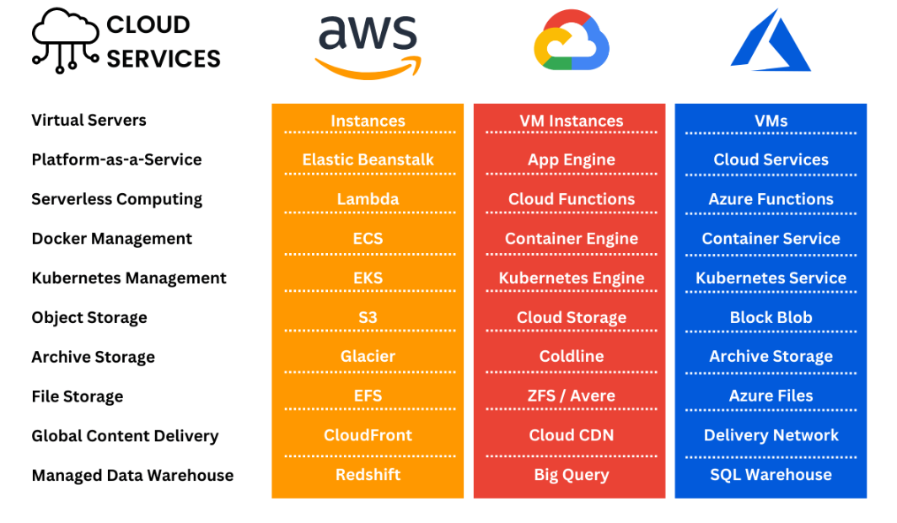

Slide 24
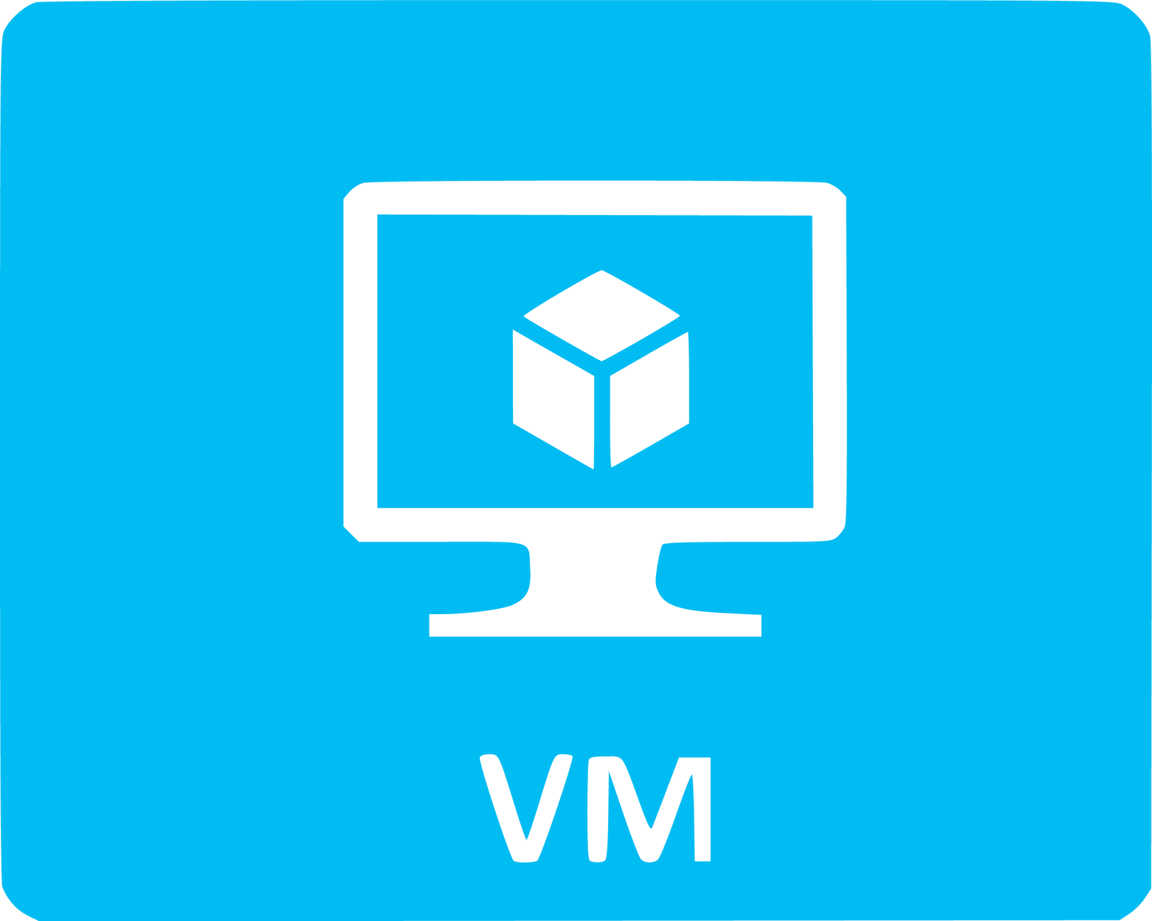
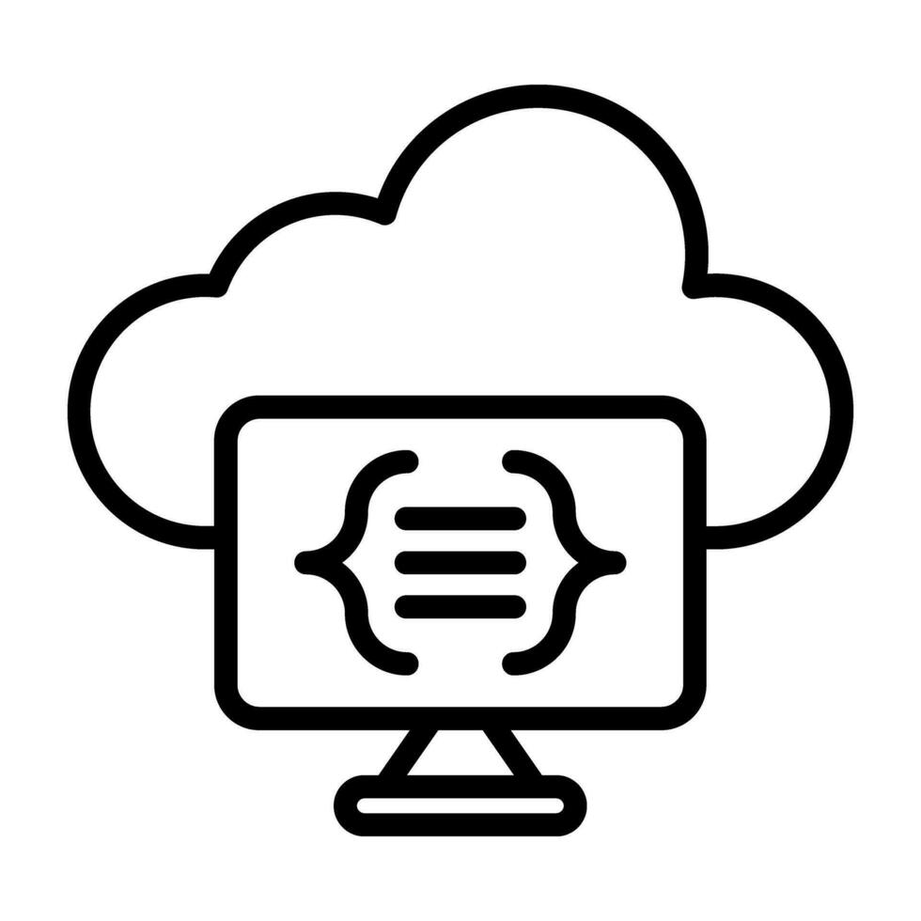

Core Cloud Services
Compute Services
Virtual Machines (VMs):
Description: Provide scalable virtualized computing resources. Users can deploy and manage VMs as needed.
Examples: AWS EC2 (Elastic Compute Cloud), Azure Virtual Machines, Google Compute Engine.
Serverless Computing:
Description: Allows users to run code in response to events without managing servers. Charges are based on the execution time and resources consumed.
Examples: AWS Lambda, Azure Functions, Google Cloud Functions.
Containers and Orchestration:
Description: Enable the deployment and management of containerized applications. Containers encapsulate an application and its dependencies, while orchestration manages container deployment and scaling.
Examples: AWS ECS (Elastic Container Service), Azure Kubernetes Service (AKS), Google Kubernetes Engine (GKE).

Slide 25
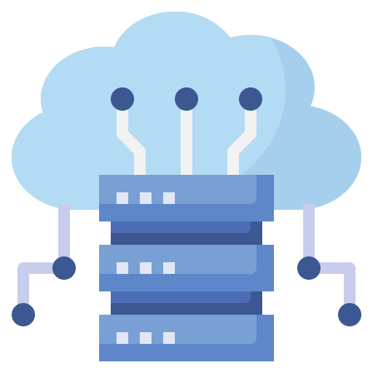
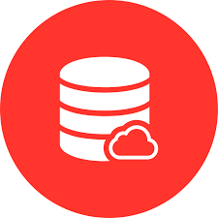
Storage Services:
Object Storage:
Description: Provides scalable and durable storage for unstructured data such as files, images, and backups. Access is usually via APIs.
Examples: AWS S3 (Simple Storage Service), Azure Blob Storage, Google Cloud Storage.
Block Storage:
Description: Provides storage volumes that can be attached to VMs for low-latency, high-performance data access.
Examples: AWS EBS (Elastic Block Store), Azure Managed Disks, Google Persistent Disks.
File Storage:
Description: Offers a managed file system for storing and sharing files over a network with standard file system protocols.
Examples: AWS EFS (Elastic File System), Azure Files, Google Cloud Filestore.
Database Services :
Relational Databases:
Description: Managed services for relational databases, which use structured query language (SQL) for querying and managing data.
Examples: AWS RDS (Relational Database Service), Azure SQL Database, Google Cloud SQL.
NoSQL Databases:
Description: Managed services for non-relational databases, which are designed for unstructured data and provide high performance and scalability.
Examples: AWS DynamoDB, Azure Cosmos DB, Google Cloud Firestore.
Data Warehousing:
Description: Services for large-scale data storage and analysis, often used for business intelligence and analytics.
Examples: AWS Redshift, Azure Synapse Analytics, Google BigQuery

Slide 26

Networking Services
Virtual Networks:
Description: Provides isolated, secure networking environments within the cloud for deploying and managing resources.
Examples: AWS VPC (Virtual Private Cloud), Azure Virtual Network, Google Cloud VPC.
Load Balancing:
Description: Distributes incoming network traffic across multiple servers to ensure high availability and reliability.
Examples: AWS ELB (Elastic Load Balancing), Azure Load Balancer, Google Cloud Load Balancing.
Content Delivery Network (CDN):
Description: Distributes content to users from locations closer to them to improve performance and reduce latency.
Examples: AWS CloudFront, Azure CDN, Google Cloud CDN.

Slide 27
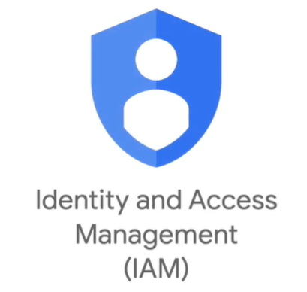

Identity and Access Management (IAM)
Description: Manages user identities and access to cloud resources, including permissions, roles, and policies.
Examples: AWS IAM, Azure Active Directory, Google Cloud IAM.
Monitoring and Management
Monitoring:
Description: Provides tools for tracking and analyzing the performance and health of cloud resources and applications.
Examples: AWS CloudWatch, Azure Monitor, Google Cloud Operations Suite.
Logging:
Description: Captures and stores log data for auditing, troubleshooting, and performance analysis.
Examples: AWS CloudTrail, Azure Log Analytics, Google Cloud Logging.

Slide 28

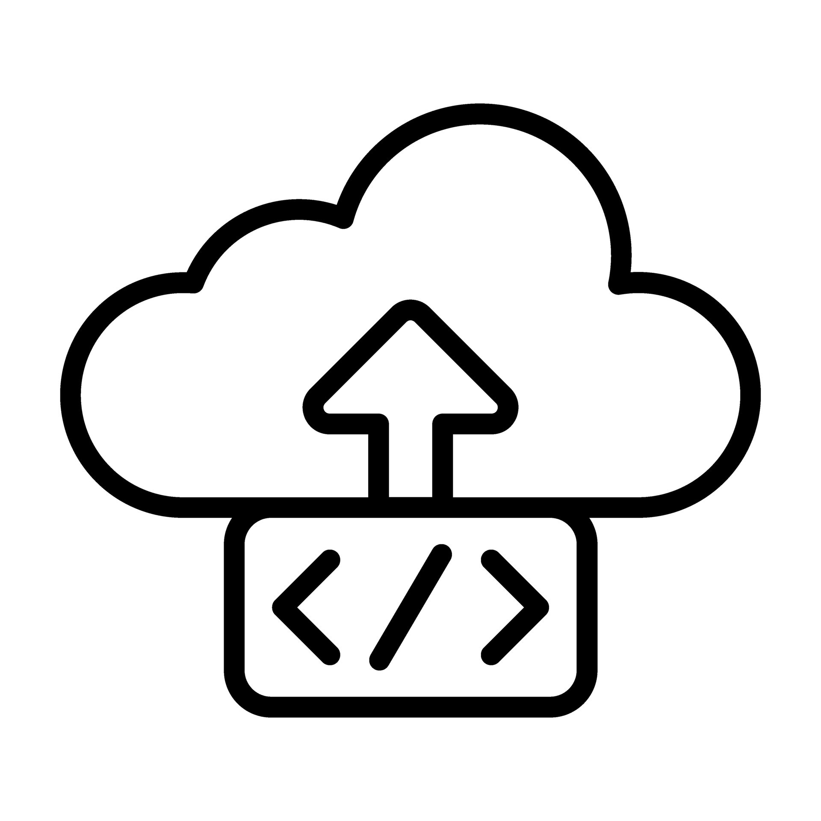

Security and Compliance
Encryption:
Description: Services for encrypting data at rest and in transit to protect against unauthorized access.
Examples: AWS KMS (Key Management Service), Azure Key Vault, Google Cloud Key Management.
Security Posture Management:
Description: Tools for assessing and managing the security posture of cloud resources and configurations.
Examples: AWS Security Hub, Azure Security Center, Google Cloud Security Command Center.
Application Development and Deployment
Development Tools:
Description: Services and tools for developing, testing, and deploying applications in the cloud.
Examples: AWS CodeBuild, Azure DevOps, Google Cloud Build.
Application Hosting:
Description: Managed platforms for hosting web applications and services, including scaling and management.
Examples: AWS Elastic Beanstalk, Azure App Services, Google App Engine.

Slide 29
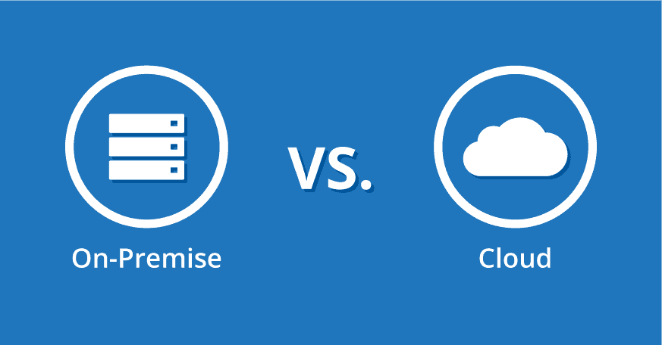

Slide 30
Difference between On-Prem and Cloud
Infrastructure Ownership and Management
On-Premises:
Ownership: The organization owns and maintains the physical hardware and infrastructure.
Management: The organization is responsible for all aspects of infrastructure management, including hardware, software, and networking.
Cloud:
Ownership: The cloud provider owns and manages the physical hardware and infrastructure.
Management: The cloud provider handles the management of hardware, software updates, and networking, while the organization manages the configuration and deployment of applications.
Cost Structure
On-Premises:
Capital Expenditure (CapEx): Significant upfront investment in hardware, software licenses, and data center facilities.
Operational Costs: Ongoing costs for maintenance, power, cooling, and staffing.
Cloud:
Operational Expenditure (OpEx): Pay-as-you-go or subscription-based pricing models, with costs based on resource usage and consumption.
Cost Management: Flexibility to scale resources up or down as needed, potentially reducing costs compared to maintaining excess capacity.

Slide 31
Scalability and Flexibility
On-Premises:
Scalability: Scaling requires purchasing and installing additional hardware, which can be time-consuming and costly.
Flexibility: Limited flexibility to adapt to changing needs without additional investments in infrastructure.
Cloud:
Scalability: Easily scale resources up or down based on demand, with minimal delay and without needing physical hardware adjustments.
Flexibility: High flexibility to quickly deploy and adjust applications, adapt to changing business requirements, and experiment with new technologies.
Performance and Availability
On-Premises:
Performance: Performance depends on the capacity and configuration of the organization's hardware and network.
Availability: Requires investment in redundancy and failover solutions to ensure high availability and disaster recovery.
Cloud:
Performance: Generally offers high performance with access to a global network of data centers and advanced infrastructure.
Availability: Cloud providers offer built-in redundancy and high availability features, often backed by SLAs (Service Level Agreements).

Slide 32
Security and Compliance
On-Premises:
Security: Direct control over physical and network security, allowing for customized security measures.
Compliance: Easier to ensure compliance with specific regulatory or data privacy requirements by controlling the entire infrastructure.
Cloud:
Security: Shared responsibility model where the cloud provider manages security of the underlying infrastructure, while the organization manages security of data and applications.
Compliance: Cloud providers often have certifications and compliance measures in place, but organizations must ensure that their usage aligns with regulatory requirements.
Maintenance and Upgrades
On-Premises:
Maintenance: Organizations are responsible for maintaining hardware, software updates, and troubleshooting.
Upgrades: Requires planning and investment to upgrade hardware and software.
Cloud:
Maintenance: The cloud provider handles maintenance, updates, and patches for infrastructure and services.
Upgrades: Regular updates and new features are provided automatically by the cloud provider.

Slide 33
Disaster Recovery and Backup
On-Premises:
Disaster Recovery: Requires investment in backup solutions and disaster recovery plans, which can be complex and costly.
Backup: Managed internally, with the need for physical storage solutions and redundancy.
Cloud:
Disaster Recovery: Cloud providers often include disaster recovery solutions and backup services as part of their offerings, simplifying recovery processes.
Backup: Managed by the provider, with options for automated backups and data replication.
Deployment Speed
On-Premises:
Deployment Speed: Setting up and deploying new infrastructure can be time-consuming due to procurement and installation processes.
Cloud: Deployment Speed: Rapid deployment of resources and services, often within minutes, allowing for quick experimentation and scaling.

Slide 34
Thanks You

